Slide 1
Návrh zabezpečení hybridního scénáře, kdy na straně Cloudu je IaaS služba
Ing. Martin Kotas
+420 724 427 207, martin@startoffice.cz

Slide 2

Content
Users:
customers, emploees, contractors, guests, etc.
Private Cloud
OnPrem sources
Public Cloud
External sources
Connection

Slide 3
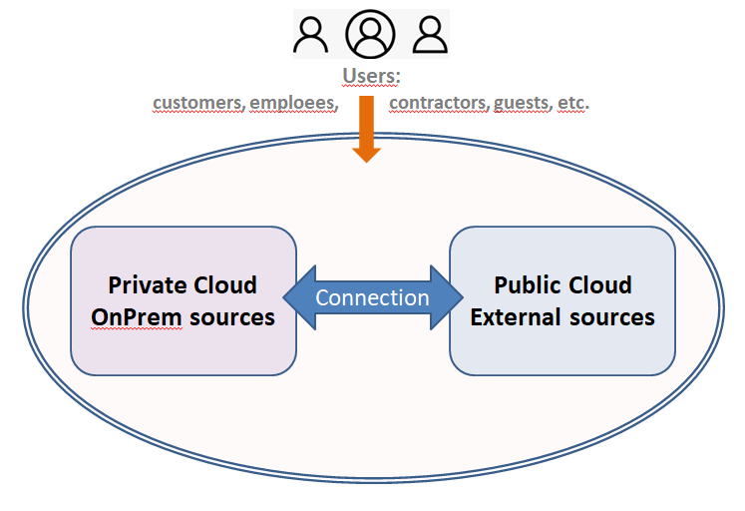
Threat landscape
Identity compromise
Cloud misconfiguration
API attacks
Insider Threat
Supply Chain Attacks
Abuse of Cloud Resources
DDoS / availability attacks
Multi-Tenant Isolation Failure
..??..

Slide 4
Usefull frameworks for the Cloud Security Managemenet
ISO 27001
NIS2 (EU) > NZoKB (CZ) (AM, RM, IM, VZ,..)
Security Operation Controls 2 (type I. – II.)
  Security (MUST)
  Availability
  Processing integrity (?)
  Confidentiality
  Privacy (?)

Slide 5
Subsystems – Layers 1/2
 | Identity | Network | Compute
Architecture: Security goals: People/HR: | Identity provider, SSO, Federation, MFA, RBAC access provisioning access revocation least privilege logical access controls IdM-admins, API-specs, API-dev | VirtNets, firewall, segmentationm, DMZ, private endpoints Network security network isolation firewall rules intrusion detection Vendor-specs (fw, netboxes) | VM, VDI, Containers System operations patch management, vulnerability scanning, host security Vendor-specs, DevOps (automation, containers)
SW tools: | Microsoft Entra ID Okta, Apache_Syncope | Azure Firewall Palo Alto Networks, AI CFGs check | VMware, OpenStack Kubernetes, Docker, AI CFGs check.

Slide 6
Subsystems – Layers 2/2
 | Data | Monitoring | Compliance / Governance
Architecture: | Encryption Key management Data classification, DLP | log SIEM alerting incident response | Policy management Audit evidence
Security goals: People/HR: SW tools: | Encryption at rest and in transit Data access logging Data protection Vendor-spec-backup e.g. Azure Key Vault Symantec DLP, MS PureView | Security logging, Anomaly detection, Incident response Vendor-spec-mgmt. -siem e.g.: Microsoft Sentinel Splunk, AWS CloudWatch Syslog :) AI DBs check | Change management User awareness Risk mitigation Security-manager. e.g. Azure/EntraId Policy 3rd pty tools for InfoSecurity

Slide 7
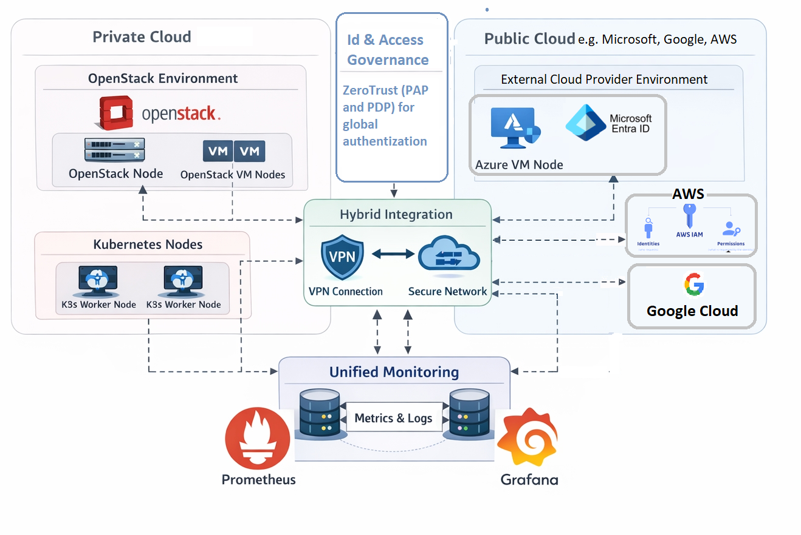
Cloud Design
Users:
customers, emploees, contractors, guests, etc.

Slide 8
Questions?
Identity
Network
Compute
Data
Monitoring
Compliance

Slide 9
Microsoft Azure hybrid Cloud
User schema
Users > Entra ID >
> Conditional Access > Microsoft 365 ( SharePoint, Teams, OneDrive,
Exchange )
> Microsoft Purview
( Sensitivity Labels
DLP
Insider Risk
Audit )
> Provider IaaS Hybrid Infrastructure
( On-prem systems, DomainControlers,..
SaaS apps, microservices,
SIEM / SOC )

Slide 10
Cloud Misconfiguration
Co to je:
Nesprávné nastavení cloudových služeb (IaaS, storage, SaaS), které vystavuje data nebo systémy.
Rizika pro hybrid provider:
  veřejně dostupné S3 buckets nebo NAS
  nesprávně nastavené access policies v SharePoint / Teams
  nadbytečné práva pro service accounts
  nepovolený externí přístup k IaaS VM
Typické scénáře:
  Storage buckets bez encryption / access control
  VM s otevřenými RDP / SSH porty
  Nadměrná práva pro uživatele či aplikace
Mitigace:
  Periodické cloud security posture assessment (CSPM)
  Hardened baseline pro IaaS / SaaS
  Automatizované auditní skripty
  Policy-as-code pro storage a VM konfigurace

Slide 11
Identity Compromise
Útočník získá přístup k identity (uživatelský účet nebo service principal) a tím i k citlivým datům nebo cloud prostředkům.
Rizika pro hybrid provider:
  přístup k M365 tenantům zákazníků
  manipulace s SharePoint / OneDrive daty
  obejití DLP a sensitivity labels
  krádež klíčů pro IaaS (VM, storage, S3 buckets)
Typické útoky:
  Phishing / credential harvesting
  Brute force / password spraying
  Token theft / session hijacking
Mitigace:
  MFA povinně pro všechny uživatele a adminy
  Conditional Access (např. jen z managed devices)
  Privileged Identity Management (PIM) pro admin role
  Continuous monitoring a alerting (Microsoft Sentinel, Cloud App Security)
API Attacks
Útoky cílené na cloudové nebo aplikacní API, často za účelem exfiltrace dat nebo privilege escalation.
  zneužití M365 / SharePoint / Purview API
  obejití DLP a sensitivity labels
  manipulace s tenant settings nebo IaaS provisioning
  krádež dat z custom storage / SaaS integrací
Typické útoky:
  Credential stuffing přes API tokeny
  Abuse of OAuth / service principal permissions
  Rate limiting bypass / automated scraping
Mitigace:
  API rate limiting a monitoring
  OAuth token governance
  Privilege segmentation (principle of least privilege)
  Logging a alerting API access v Sentinel / Cloud App Security

